Slide 1
Middleware
Middleware provide a convenient mechanism for inspecting and filtering HTTP requests entering your application.
All of these middleware are located in the app/Http/Middleware directory.
Defining Middleware
php artisan make:middleware MiddlewareName
artisan vendor:publish --tag=laravel-errors

Slide 2
Registering Middleware
Global Middleware
Assigning Middleware to Routes
Middleware Groups

Slide 3
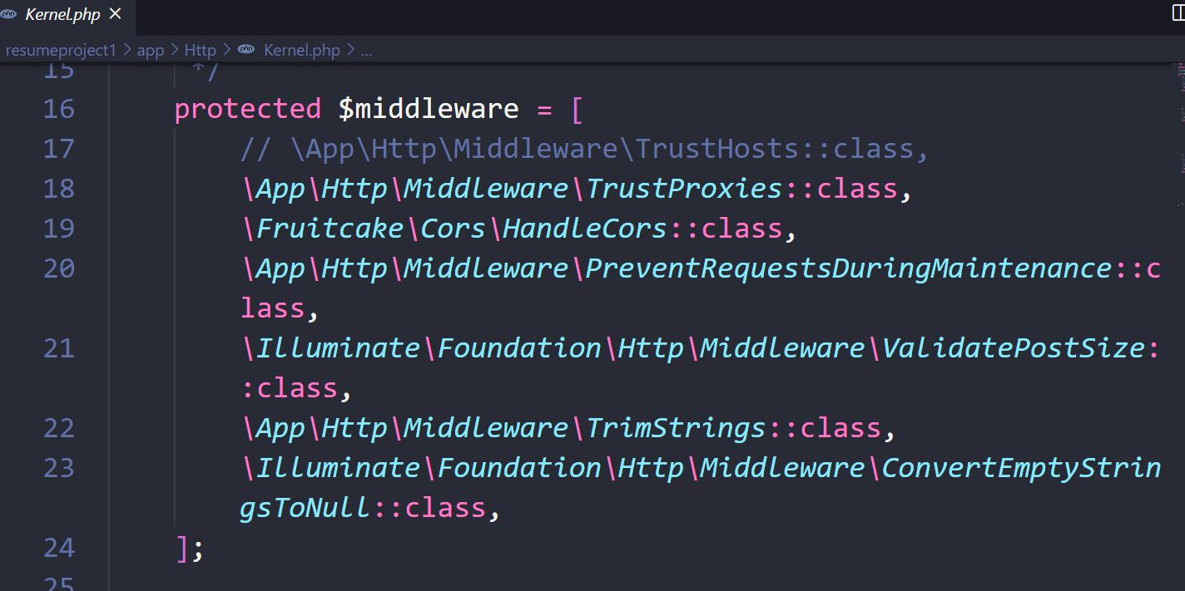
Global Middleware
If you want a middleware to run during every HTTP request to your application, list the middleware class in the $middleware property of your app/Http/Kernel.php

Slide 4
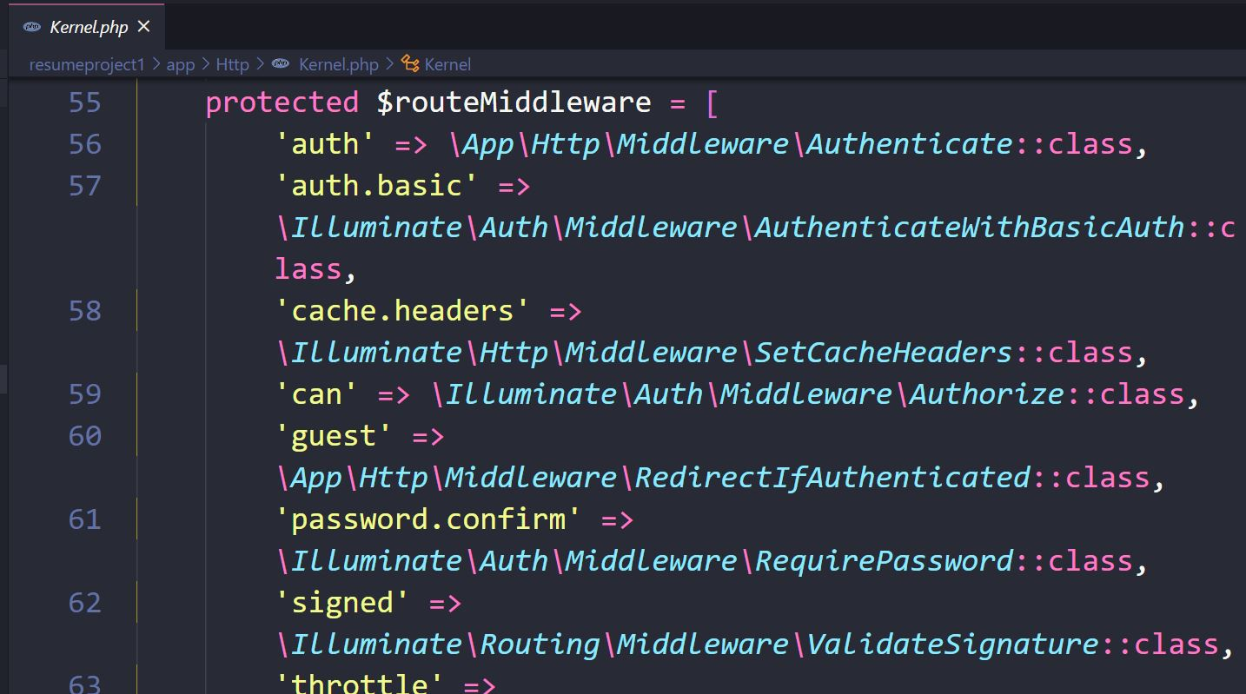
Assigning Middleware to Routes
If you would like to assign middleware to specific routes, You have to add your own middleware to list and assign it a key of your choosing in the $routeMiddleware property of your application's app/Http/Kernel.php

Slide 5
Assigning Middleware to Routes
Once the middleware has been defined in the HTTP kernel, you may use the middleware method to assign middleware to a route.
Route::get('/profile', function () {
//
})->middleware('auth’);
You may assign multiple middleware to the route by passing an array of middleware names to the middleware method.
Route::get('/', function () {
//
})->middleware(['first', 'second']);

Slide 6
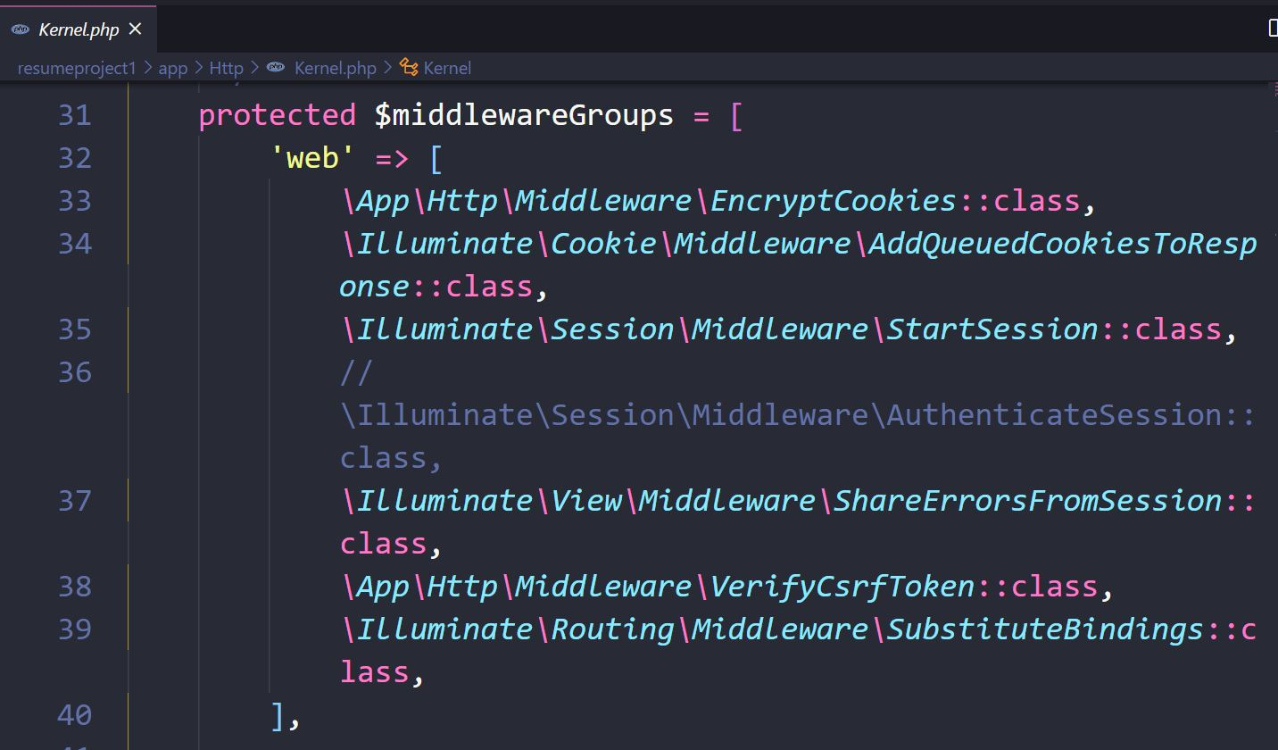
Middleware Groups
If you may want to group several middleware under a single key to make them easier to assign to routes. You may accomplish this using the $middlewareGroups property of your HTTP kernel.

Slide 7
Middleware Groups
Middleware groups may be assigned to routes and controller actions using the same syntax as individual middleware.
Route::get('/', function () {
//
})->middleware('web’);
Route::middleware(['web'])->group(function () {
// Write those routes which are supposed to use this middleware
});

Slide 8
Middleware Parameter
Middleware can also receive additional parameters.
Additional middleware parameters will be passed to the middleware after the $next argument.
public function handle($request, Closure $next, $role)
{
if (! $request->user()->hasRole($role)) {
// Redirect...
}
return $next($request);
}

Slide 9
Middleware Parameter
Middleware parameters may be specified when defining the route by separating the middleware name and parameters with a :. Multiple parameters should be delimited by commas.
Route::put('/post/{id}', function ($id) {
//
})->middleware('role:editor');

